Slide 1
Cornerstone City Church Peninsula Plus Community Hoo Are Ya
8th February 2026

Slide 2
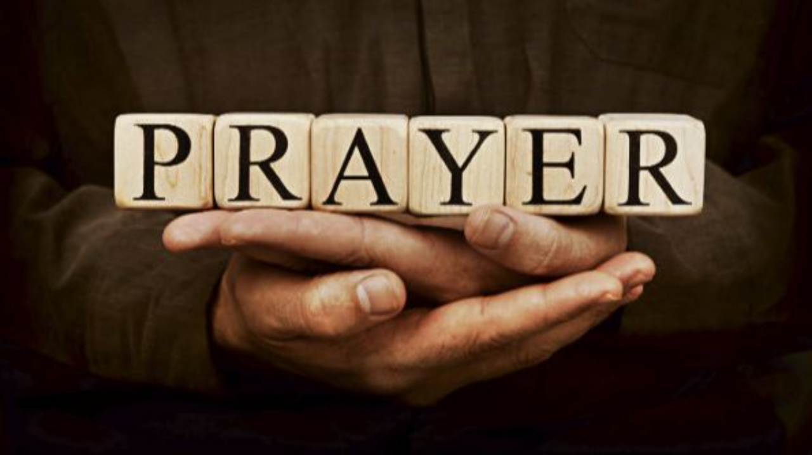

Slide 3
Firm Foundation (He Won't)
CCLI Song # 7188203
Austin Davis | Chandler Moore | Cody Carnes
© 2021 For Humans Publishing (Admin by Essential Music Publishing)
Maverick City Publishing (Admin by Essential Music Publishing)
Capitol CMG Paragon (Admin. by Capitol CMG Publishing)
TBCO Publishing (Admin. by Capitol CMG Publishing)
Writer's Roof Publishing (Admin. by Capitol CMG Publishing)
A.L.K.D. Music (Admin. by Watershed Music Group (Admin. by Capitol CMG Publishing))
For use solely with the SongSelect® Terms of Use. All rights reserved. www.ccli.com
CCLI Licence No. 33265

Slide 4
1/11
Christ is my firm foundation
The rock on which I stand
When everything around me is shaken
I've never been more glad

Slide 5
2/11
That I put my faith in Jesus
'Cause He's never let me down
He's faithful through generations
So why would He fail now

Slide 6
3/11
He won’t
He won't

Slide 7
4/11
I've still got joy in chaos
I've got peace that makes no sense
So I won't be going under
I'm not held by my own strength

Slide 8
5/11
'Cause I've built my life on Jesus
He's never let me down
He's faithful in every season
So why would He fail now

Slide 9
6/11
He won’t He won't
He won't fail
He won't fail

Slide 10
7/11
Rain came and wind blew
My house was built on You
I'm safe with You
I'm going to make it through

Slide 11
8/11
I'm going to make it through
‘Cause I’m standing strong on You
I’m going to make it through
‘Cause my house is built on You

Slide 12
9/11
Christ is my firm foundation
The rock on which I stand
When everything around me is shaken
I've never been more glad

Slide 13
10/11
That I put my faith in Jesus
'Cause He's never let me down
He's faithful through generations
So why would He fail now

Slide 14
11/11
He won’t He won't
He won't fail
He won't fail

Slide 15
Your Love Never Fails
CCLI Song # 5337172
Anthony Skinner | Chris McClarney
© 2008 Integrity's Alleluia! Music (Admin. by Integrity Music Ltd)
Out Of The Cave Music (Admin. by Integrity Music Ltd)
Thankyou Music (Admin. by Integrity Music Ltd)
For use solely with the SongSelect® Terms of Use. All rights reserved. www.ccli.com
CCLI Licence No. 33265

Slide 16
1/6
Nothing can separate
Even if I ran away
Your love never fails
I know I still make mistakes but
You have new mercies for me ev'ryday
Your love never fails

Slide 17
2/6
(And) You stay the same through the ages
Your love never changes
There may be pain in the night
But joy comes in the morning
And when the oceans rage
I don't have to be afraid
Because I know that You love me
(Your love never fails)

Slide 18
3/6
The wind is strong and the water's deep
But I'm not alone here in these open seas
Your love never fails
The chasm is far too wide
I never thought I'd reach the other side
Your love never fails

Slide 19
4/6
(And) You stay the same through the ages
Your love never changes
There may be pain in the night
But joy comes in the morning
And when the oceans rage
I don't have to be afraid
Because I know that You love me
(Your love never fails)

Slide 20
5/6
You make all things
Work together for my good
You make all things
Work together for my good

Slide 21
6/6
(And) You stay the same through the ages
Your love never changes
There may be pain in the night
But joy comes in the morning
And when the oceans rage
I don't have to be afraid
Because I know that You love me
(Your love never fails)

Slide 22
O Come To The Altar
CCLI Song # 7051511
Chris Brown | Mack Brock | Steven Furtick | Wade Joye
© 2015 Music by Elevation Worship Publishing
For use solely with the SongSelect® Terms of Use. All rights reserved. www.ccli.com
CCLI Licence No. 33265

Slide 23
1/7
Are you hurting and broken within
Overwhelmed by the weight of your sin
Jesus is calling
Have you come to the end of yourself
Do you thirst for a drink from the well
Jesus is calling

Slide 24
2/7
O come to the altar
The Father's arms are open wide
Forgiveness was bought with
The precious blood of Jesus Christ

Slide 25
3/7
Leave behind your regrets and mistakes
Come today there's no reason to wait
Jesus is calling
Bring your sorrows and trade them for joy
From the ashes a new life is born
Jesus is calling

Slide 26
4/7
O come to the altar
The Father's arms are open wide
Forgiveness was bought with
The precious blood of Jesus Christ (REPEAT)

Slide 27
5/7
Oh what a Savior
Isn't he wonderful
Sing alleluia Christ is risen
Bow down before him
For he is Lord of all
Sing alleluia Christ is risen

Slide 28
6/7
O come to the altar
The Father's arms are open wide
Forgiveness was bought with
The precious blood of Jesus Christ

Slide 29
7/7
Bear your cross as you wait for the crown
Tell the world of the treasure you've found

Slide 30
Waiting Here For You
CCLI Song # 5925663
Chris Tomlin | Jesse Reeves | Martin Smith
© 2011 Rising Springs Music (Admin. by Capitol CMG Publishing)
Vamos Publishing (Admin. by Capitol CMG Publishing)
worshiptogether.com songs (Admin. by Capitol CMG Publishing)
Smith United (Admin. by Integrity Music Ltd)
Thankyou Music (Admin. by Integrity Music Ltd)
For use solely with the SongSelect® Terms of Use. All rights reserved. www.ccli.com
CCLI Licence No. 33265

Slide 31
1/7
If faith can move the mountains
Let the mountains move
We come with expectation
Waiting here for You
Waiting here for You

Slide 32
2/7
You're the Lord of all creation
And still You know my heart
The Author of salvation
You've loved us from the start

Slide 33
3/7
Waiting here for You with our hands
Lifted high in praise
And it's You we adore
Singing alleluia

Slide 34
4/7
You are ev'rything You've promised
Your faithfulness is true
We're desp'rate for Your presence
All we need is You

Slide 35
5/7
We will wait for You Lord
In step with You Lord we sing alleluia

Slide 36
6/7
Singing alleluia alleluia
Singing alleluia alleluia

Slide 37
7/7
Waiting here for You with our hands
Lifted high in praise
And it's You we adore singing alleluia
(We’re) singing alleluia

Slide 39
Raise A Hallelujah
CCLI Song # 7119315
Jake Stevens | Jonathan David Helser | Melissa Helser | Molly Skaggs
© 2018 Bethel Music Publishing (Admin. by Song Solutions)
For use solely with the SongSelect® Terms of Use. All rights reserved. www.ccli.com
CCLI Licence No. 33265

Slide 40
1/8
I raise a hallelujah in the presence of my enemies I raise a hallelujah louder than the unbelief I raise a hallelujah my weapon is a melody I raise a hallelujah Heaven comes to fight for me

Slide 41
2/8
I’m gonna sing in the middle of the storm Louder and louder you’re gonna hear my praises roar Up from the ashes hope will arise Death is defeated the King is alive

Slide 42
3/8
I raise a hallelujah with everything inside of me I raise a hallelujah I will watch the darkness flee I raise a hallelujah in the middle of the mystery I raise a hallelujah fear you lost your hold on me

Slide 43
4/8
I’m gonna sing in the middle of the storm Louder and louder you’re gonna hear my praises roar Up from the ashes hope will arise Death is defeated the King is alive

Slide 44
5/8
Sing a little louder (Sing a little louder) Sing a little louder (Sing a little louder)

Slide 45
6/8
Sing a little louder in the presence of my enemies Sing a little louder, louder than the unbelief Sing a little louder my weapon is a melody Sing a little louder Heaven comes to fight for me

Slide 46
7/8
I’m gonna sing in the middle of the storm Louder and louder you’re gonna hear my praises roar Up from the ashes hope will arise Death is defeated the King is alive REPEAT

Slide 47
8/8
I raise a hallelujah in the presence of my enemies I raise a hallelujah louder than the unbelief I raise a hallelujah my weapon is a melody I raise a hallelujah Heaven comes to fight for me

Slide 48
Cornerstone
CCLI Song # 6158927
Edward Mote | Eric Liljero | Jonas Myrin | Reuben Morgan | William Batchelder Bradbury
© 2011 Hillsong MP Songs (Admin. by Hillsong Music Publishing UK)
Hillsong Music Publishing Australia (Admin. by Hillsong Music Publishing UK)
Hillsong Music Publishing UK
For use solely with the SongSelect® Terms of Use. All rights reserved. www.ccli.com
CCLI Licence No. 33265

Slide 49
1/6
My hope is built on nothing less
Than Jesus' blood and righteousness
I dare not trust the sweetest frame
But wholly trust in Jesus' Name

Slide 50
2/6
Christ alone cornerstone
Weak made strong in the Saviour's love
Through the storm He is Lord
Lord of all

Slide 51
3/6
When darkness seems to hide His face
I rest on His unchanging grace
In every high and stormy gale
My anchor holds within the veil
My anchor holds within the veil

Slide 52
4/6
Christ alone cornerstone
Weak made strong in the Saviour's love
Through the storm He is Lord
Lord of all

Slide 53
5/6
When He shall come with trumpet sound
Oh may I then in Him be found
Dressed in His righteousness alone
Faultless stand before the throne

Slide 54
6/6
Christ alone cornerstone
Weak made strong in the Saviour's love
Through the storm He is Lord
Lord of all

Slide 55
Living Hope CCLI Song # 7106807
Brian Johnson | Phil Wickham
© 2017 Phil Wickham Music; Simply Global Songs; Sing My Songs; Bethel Music Publishing
For use solely with the SongSelect® Terms of Use. All rights reserved. www.ccli.com
CCLI Licence No. 33265

Slide 56
1/6
How great the chasm that lay between us
How high the mountain I could not climb
In desperation I turned to heaven
And spoke Your name into the night
Then through the darkness Your loving-kindness
Tore through the shadows of my soul
The work is finished the end is written
Jesus Christ my living hope

Slide 57
2/6
Who could imagine so great a mercy
What heart could fathom such boundless grace
The God of ages stepped down from glory
To wear my sin and bear my shame
The cross has spoken I am forgiven
The King of kings calls me His own
Beautiful Savior I’m Yours forever
Jesus Christ my living hope

Slide 58
3/6
Hallelujah praise the One who set me free
Hallelujah death has lost its grip on me
You have broken every chain
There’s salvation in Your name
Jesus Christ my living hope

Slide 59
4/6
Then came the morning that sealed the promise
Your buried body began to breathe
Out of the silence the Roaring Lion
Declared the grave has no claim on me
(REPEAT)
Jesus Yours is the victory whoa

Slide 60
5/6
Hallelujah praise the One who set me free
Hallelujah death has lost its grip on me
You have broken every chain
There’s salvation in Your name
Jesus Christ my living hope

Slide 61
6/6
Jesus Christ my living hope
Oh God You are my living hope

Slide 62
Still
CCLI Song # 3940963
Reuben Morgan
© 2002 Hillsong Music Publishing Australia (Admin. by Hillsong Music Publishing UK)
For use solely with the SongSelect® Terms of Use. All rights reserved. www.ccli.com
CCLI Licence No. 33265

Slide 63
1/3
Hide me now
Under Your wings
Cover me
Within Your mighty hand

Slide 64
2/3
When the oceans rise
And thunders roar
I will soar with You
Above the storm
Father You are King
Over the flood
I will be still and know
You are God

Slide 65
3/3
Find rest my soul
In Christ alone
Know His power
In quietness and trust

Slide 66
Be Still
CCLI Song # 120824
David J. Evans
© 1986 Thankyou Music Ltd
For use solely with the SongSelect® Terms of Use. All rights reserved. www.ccli.com
CCLI Licence No. 33265

Slide 67
1/3
Be still for the presence of the Lord
The Holy One is here
Come bow before Him now
With reverence and fear
In Him no sin is found
We stand on holy ground
Be still for the presence of the Lord
The Holy One is here

Slide 68
2/3
Be still for the glory of the Lord
Is shining all around
He burns with holy fire
With splendor He is crowned
How awesome is the sight
Our radiant King of light
Be still for the glory of the Lord
Is shining all around

Slide 69
3/3
Be still for the power of the Lord
Is moving in this place
He comes to cleanse and heal
To minister His grace
No work too hard for Him
In faith receive from Him
Be still for the power of the Lord
Is moving in this place

Slide 71
Never Once
CCLI Song # 5997055
Jason Ingram | Matt Redman | Tim Wanstall
© 2011 Chrysalis Music Ltd.; Spirit Nashville Three; So Essential Tunes; Spirit Nashville Three; Thankyou Music Ltd
For use solely with the SongSelect® Terms of Use. All rights reserved. www.ccli.com
CCLI Licence No. 33265

Slide 72
1/7
Standing on this mountaintop
Looking just how far we've come
Knowing that for ev'ry step You were with us

Slide 73
2/7
Kneeling on this battleground
Seeing just how much You've done
Knowing ev'ry victory was Your pow'r in us

Slide 74
3/7
Scars and struggles on the way
But with joy our hearts can say
Yes our hearts can say

Slide 75
4/7
Never once did we ever walk alone
Never once did You leave us on our own
You are faithful God You are faithful
(You are faithful God You are faithful)

Slide 76
5/7
Scars and struggles on the way
But with joy our hearts can say
Never once did we ever walk alone
Carried by Your constant grace
Held within Your perfect peace
Never once no we never walk alone

Slide 77
6/7
Never once did we ever walk alone
Never once did You leave us on our own
You are faithful God You are faithful
Ev’ry step we are breathing in Your grace
Evermore we'll be breathing out Your praise
You are faithful God You are faithful

Slide 78
7/7
You are faithful God You are faithful
REPEAT

Slide 79
Endless Hallelujah
CCLI Song # 6016557
Chris Tomlin | Jonas Myrin | Matt Redman | Tim Wanstall
© 2011 Chrysalis Music Ltd.; Atlas Mountain Songs; S. D. G. Publishing; Twelve Lions Music; Worship Together Music; Thankyou Music Ltd
For use solely with the SongSelect® Terms of Use. All rights reserved. www.ccli.com
CCLI Licence No. 33265

Slide 80
1/8
When I stand before Your throne
Dressed in glory not my own
What a joy I'll sing of on that day
No more tears or broken dreams
Forgotten is the minor key
Ev'rything as it was meant to be

Slide 81
2/8
And we will worship worship
Forever in Your presence we will sing
We will worship worship You
An endless hallelujah to the King

Slide 82
3/8
I will see You as You are
Love You with un-sinning heart
See how much You paid to bring me home
Not 'til then Lord shall I know
Not 'til then how much I owe
Ev'rything I am before Your throne

Slide 83
4/8
And we will worship worship
Forever in Your presence we will sing
We will worship worship You
An endless hallelujah to the King

Slide 84
5/8
No more tears no more shame
No more sin and sorrow ever known again
No more fears no more pain
We will see You face to face
See You face to face

Slide 85
6/8
And we will worship worship
Forever in Your presence we will sing
We will worship worship You
An endless hallelujah to the King

Slide 86
7/8
Oh
Hallelujah
Hallelujah yeah
Oh oh

Slide 87
8/8
And we will worship worship
Forever in Your presence we will sing we will sing
We will worship worship You
An endless hallelujah to the King
An endless hallelujah to the King
We'll sing an endless hallelujah to the King

Slide 88


Slide 89
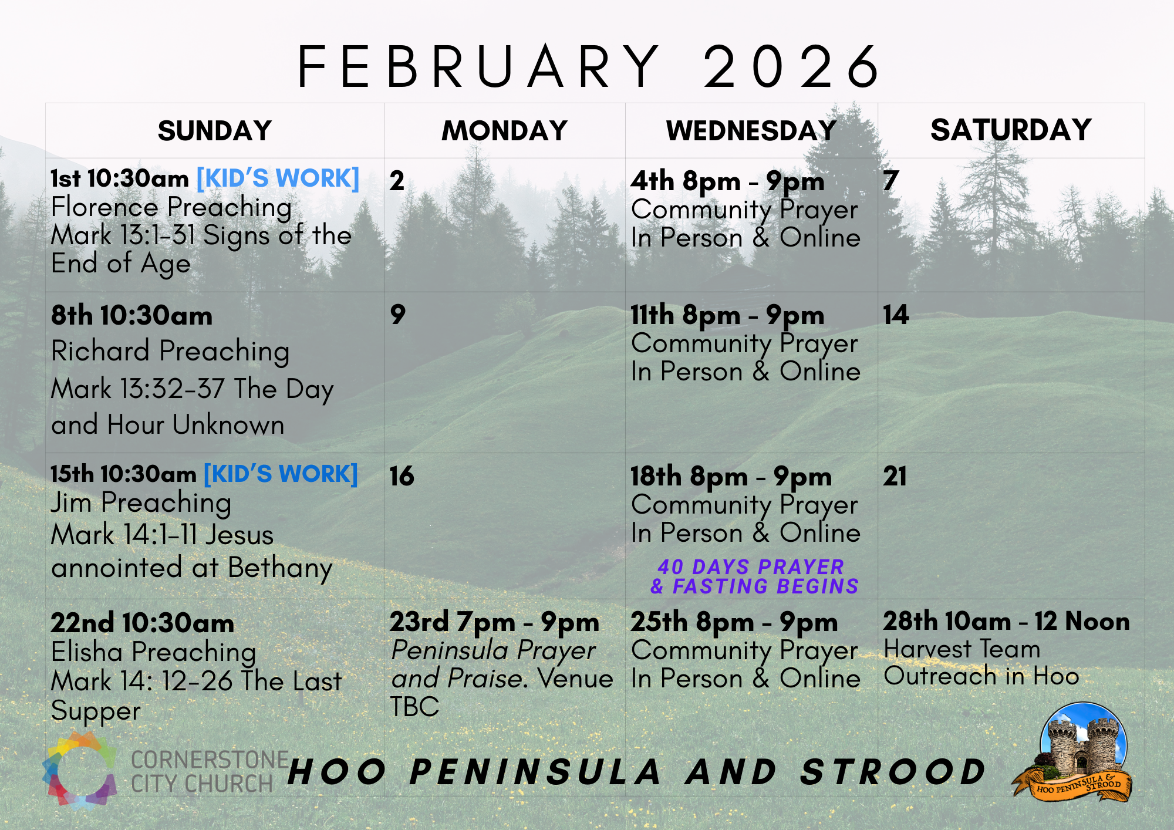

Slide 90
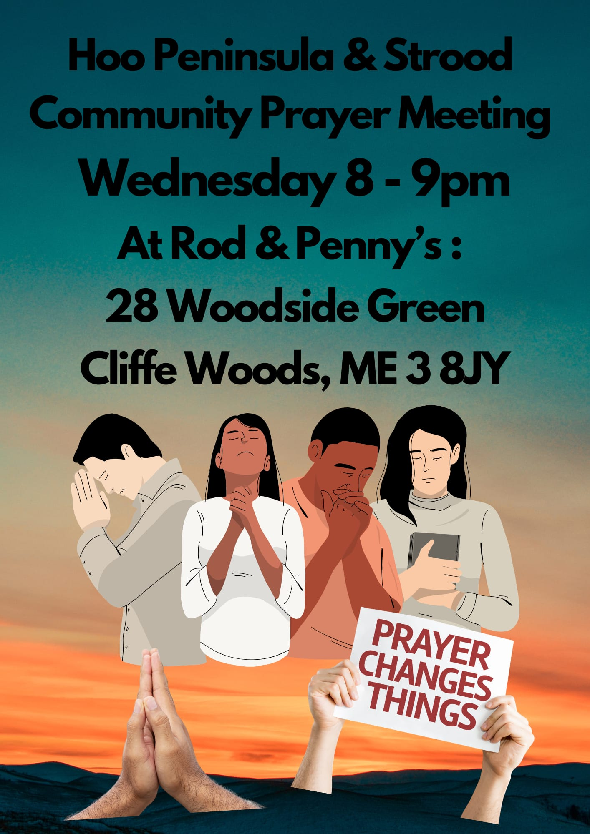

Slide 91
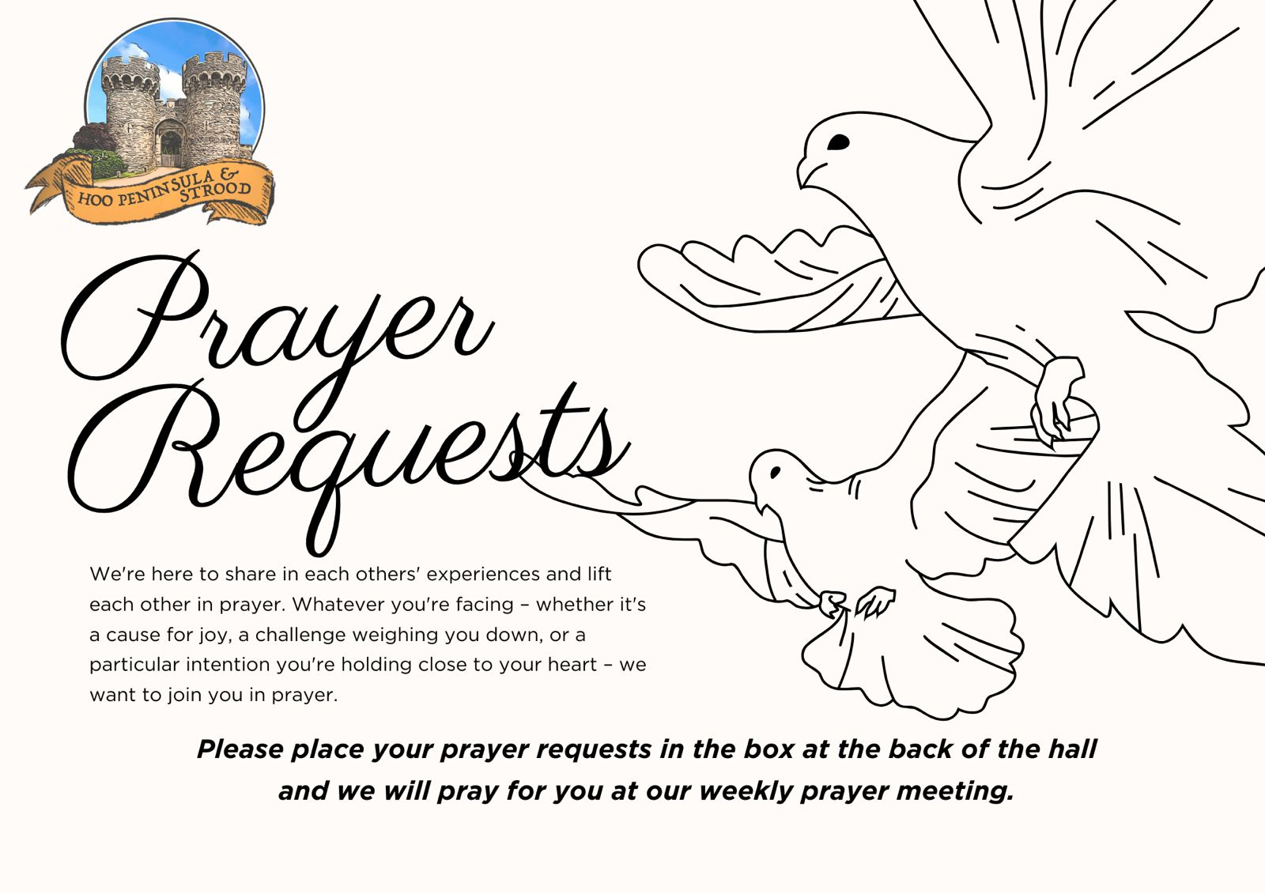

Slide 92


Slide 93
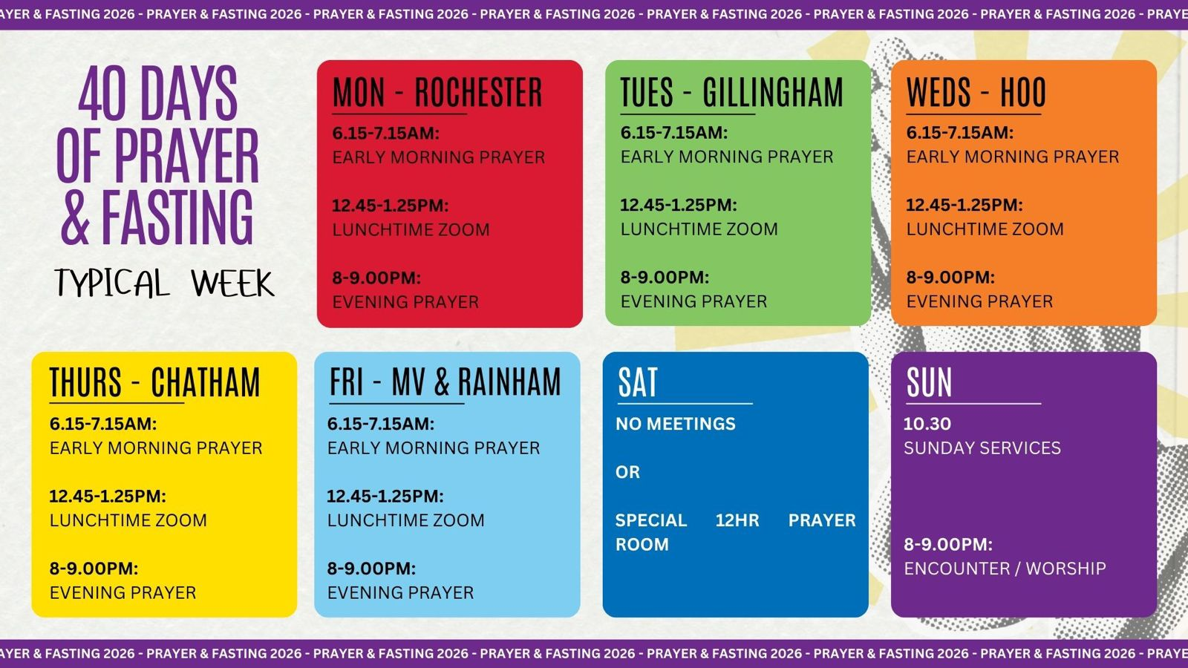

Slide 94
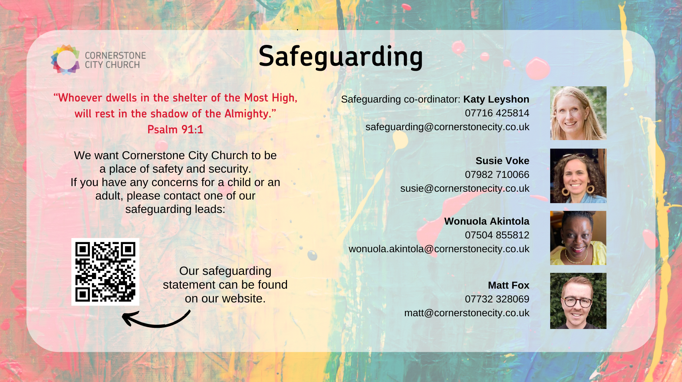

Slide 95


Slide 96
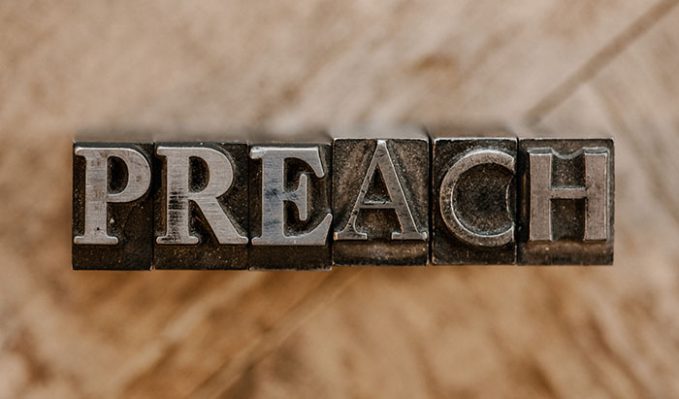

Slide 97
2 Corinthians 14 May the grace of the Lord Jesus Christ, and the love of God, and the fellowship of the Holy Spirit be with us all. And….
Surely goodness and mercy shall follow us all the days of our lives, and we shall dwell in the house of the Lord forever.

